Slide 1
Object Oriented Concepts
Lecture-04
Classes & Objects – Part 2

Slide 2




Resource Panel
Dr. Nuwan Kodagoda
Head/Senior Lecturer
Department of CSSE
Ms. Anjalie Gamage
Senior Lecturer
Department of IT
Ms. Kushnara Suriyawansa
Lecturer
Department of CSSE
Ms. Shalini Rupasinghe
Assistant Lecturer
Department of CSSE

Slide 3
Learning Outcomes
At the end of the Lecture students should be able to
Understand, identify and describe Classes, Objects, Properties and Methods
Describe Encapsulation, Information Hiding, and Interfaces

Slide 4
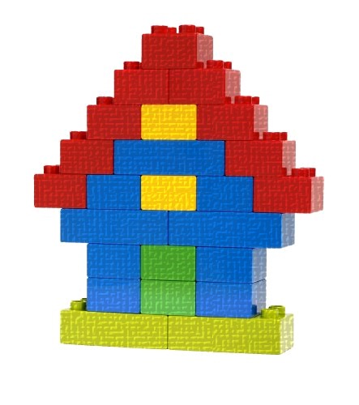
How do we develop an OO Program ?
We look at the problem that needs to be solved
This is the building we want to build
e.g. In a real world scenario this could be a Student Information System (SIS)

Slide 5
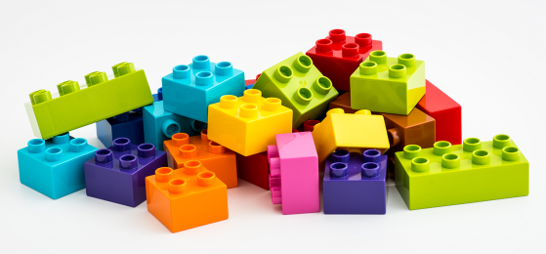
Identifying Objects needed
These are the Blocks (Objects) that we need.
e.g. In SIS objects could be details of OOC, IWT, students called Manoj, Gayani

Slide 6
How do you create these Blocks (Objects)?
What if we needed to manufacture these blocks. How could we do this? What do we need to make first?

Slide 7
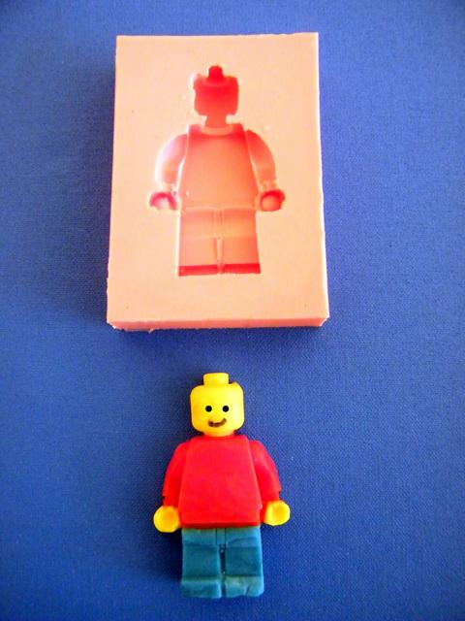
A Mould (Class)
Once we make a Mould (Class) we can make as many blocks (Object) that we need.

Slide 8
How to group these Blocks (Objects)?
How can we group these Blocks?

Slide 9
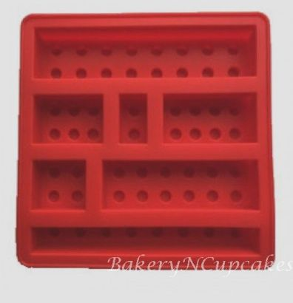
We could do it by Shape
A Square Mould (class)
A Rectangle Mould (class)
e.g. In SIS it could be Student Class, Subject Class

Slide 10
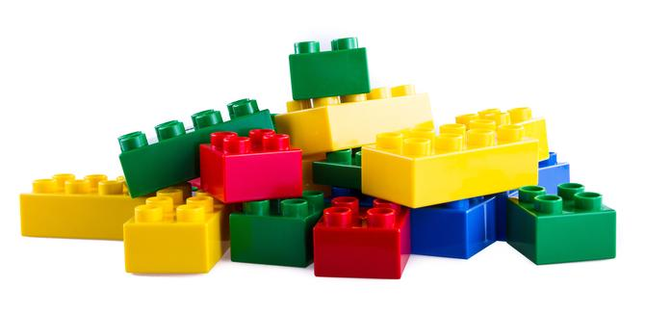
Creating Blocks (Objects) from Moulds (Classes)
A Square Mould (class)
Blocks (Objects) made
A Rectangle Mould (class)

Slide 11
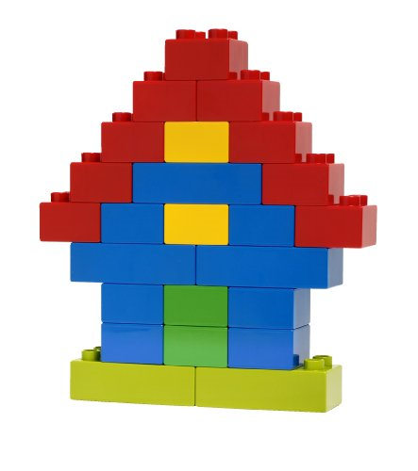
Final Product – Assembling Blocks (Objects)
We can now assemble the Objects and create our final solution.

Slide 12
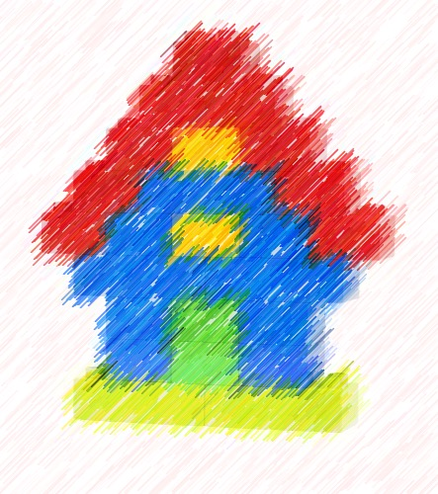

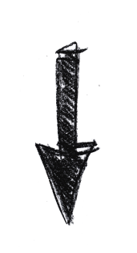
Problem to Solve
Assemble Objects to create the solution
Identify Objects that are needed
Create Objects from Classes
Identify Classes through Abstraction

Slide 13

I am dreaming of
How do you build a house?

Slide 14
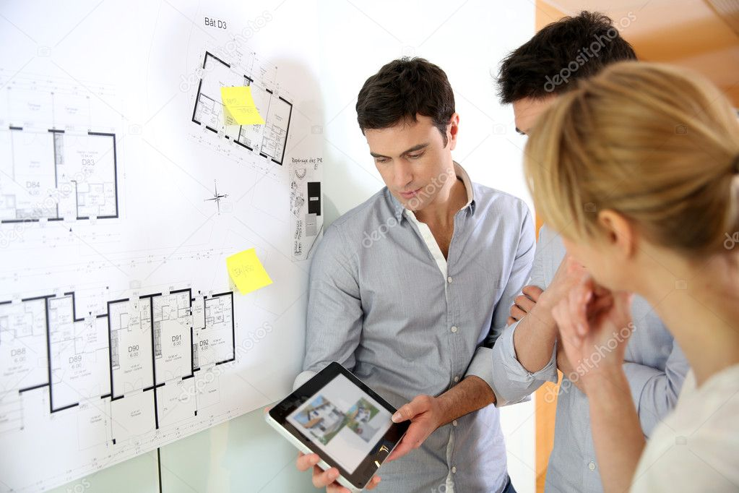
Meeting an Architect to make a House Plan (Blue Print)

Slide 15
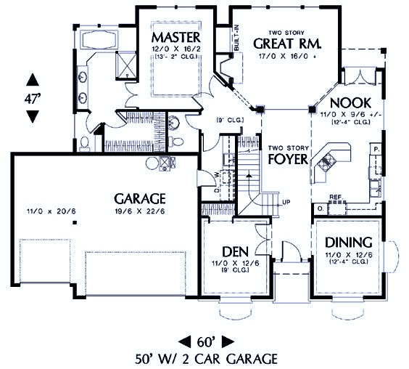
Blue Print – House Plan (Class)
Your Dream House
Class House

Slide 16
Your Dream House
With the House Plan – Blue Print (Class) you can now get a contractor to build your dream house (Object)
Class House
Object

Slide 17
Classes and Objects
An Object is a specific instance (variable) of the data type (class)
A class is a blue print of an object.
Class House
Object

Slide 18
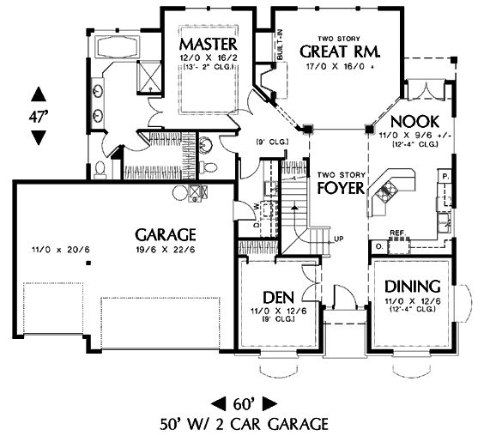
Classes and Objects
You can make as many houses as you want from a single house plan – Blue Print (Class)
House2
House1
Objects
Class House
House3

Slide 19
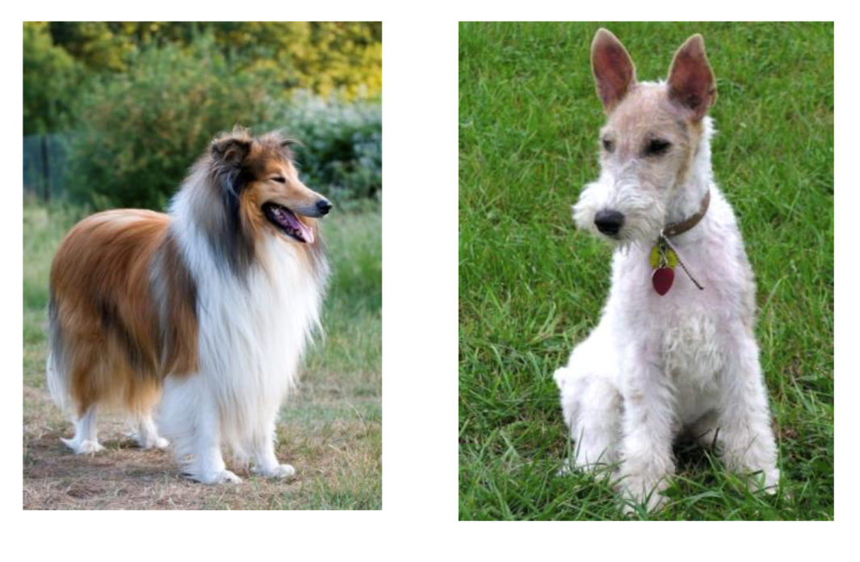
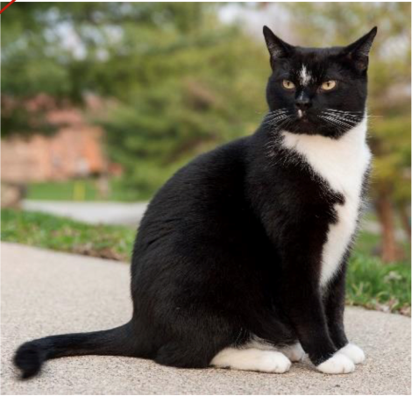
Classes – Captures Behaviour as well
A concept (class) has both properties and behavior.
We know that dogs and cats behave differently
Cat Class
Dog Class
(c) 2017 Monique Snoeck, KU LEUVEN

Slide 20
Example – Behaviour is captured as functions
Dog Class
name owner breed work (e.g. police dog)
Bark() Fetch()
Cat Class
name owner breed
Meow() Purr()
Grouping properties and functions together is called Encapsulation

Slide 21
Rectangle Class
Rectangle
length width
calcArea () calcPerimeter() getLength() getWidth() setLength() setWidth()
Class Name
Properties
(Attributes)
Functions
(Methods)
(Behaviour)

Slide 22
Employee Class
Employee
EmpNo Name Address BasicSalary OtHrs OtRate
CalculateOTAmount() CalculateNetSalary() PrintPaySlip()
Class name
Attributes
Properties
Data Members
Methods
Behaviors
member functions

Slide 23
Restricted Access
All properties and some functions of a Class have restricted access (private) and can be accessed only through public functions.
Why is this necessary?
Let’s look at an example.

Slide 24
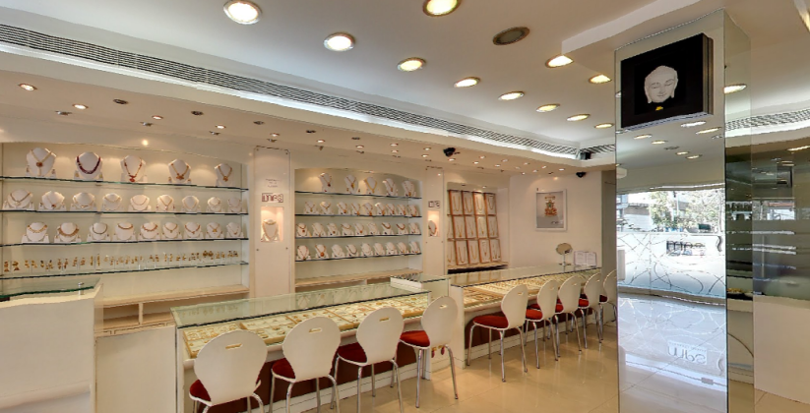
A Jewelry Shop

Slide 25
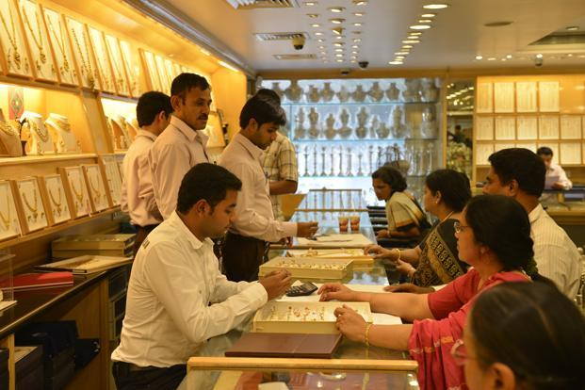
Jewelry can be accessed only through a Sales Person

Slide 26
JewelleryShop Class
JewelleryShop Class
gems jewellery
viewJewellery() buyJewellery()
Private (Restricted)
Public
(Salesman do this)

Slide 27
Information Hiding
Hide certain information or implementation decision that are internal to the encapsulation structure ( class )
The only way to access an object is through its public interface (public functions)
Public – anyone can access / see it
Private – no one except the class can see/ use it

Slide 28
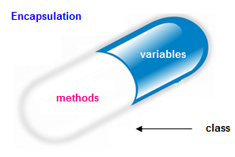

Encapsulation
It is the process of grouping related attributes and methods together, giving a name to the unit and providing an interface (public functions) for outsiders to communicate with the unit.
Notes:
Encapsulation is like a capsule which gathers the medicine into a capsule which the patient cannot see what’s inside and they see only the interface which is the outter cover of the capsule.
Example of a TV and the remote controller
TV consists of so many technologies and devices ( attributes and methods ) to operate while we do not see them from outside. The Remote can be considered as the interface ( access to methods )

Slide 29
Encapsulation
The implementation of the TV is hidden from us. Your TV could be OLED, LCD, Plasma or an old CRT one.
You can control any such TV using the same commands in your remote (interface).

Slide 30
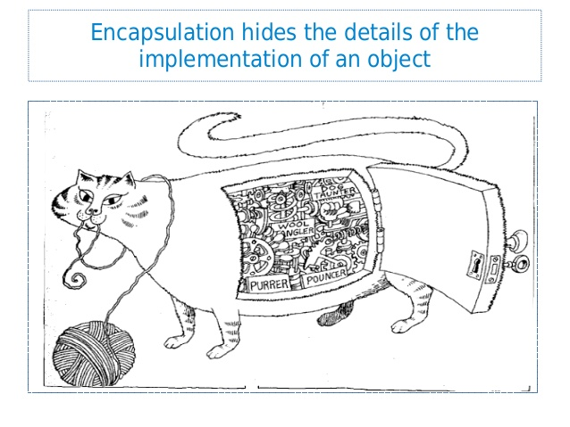
Encapsulation
( Reference : Grady Booch, eta (2008), Object Oriented Analysis and Design with Applications 3rd Edition, pg 52)

Slide 31
Encapsulation
Encapsulation is the process of compartmentalizing the elements of an abstraction that constitute its structure and behavior; encapsulation serves to separate the contractual interface of an abstraction and its implementation.
( Reference : Grady Booch, eta (2008), Object Oriented Analysis and Design with Applications 3rd Edition, pg 52)

Slide 32
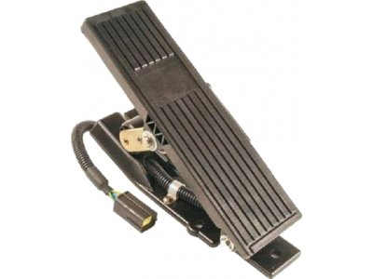
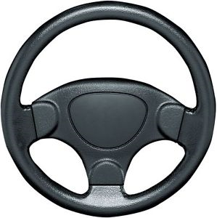
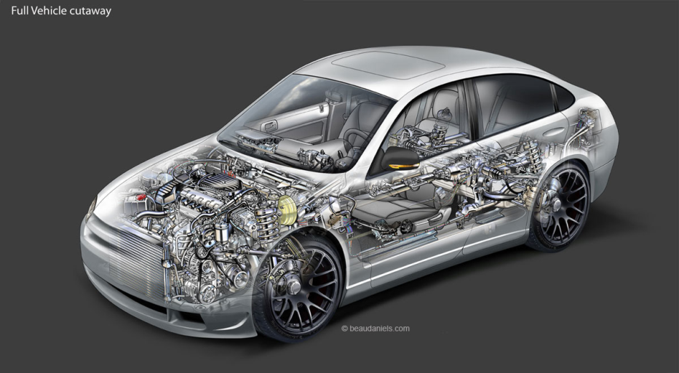

Interface – Public Functions
You interact with some object through its interfaces.
Your car can be Gasoline, Hybrid or Electric but you drive it the same way.

Slide 33
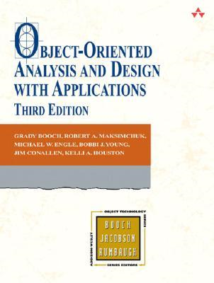
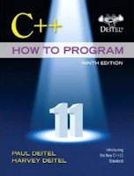
Reference
Chapter 03
Grady Booch (2008), Object-Oriented Analysis and Design with Application,
3rd Edition
Chapter 09
Deitel & Deitel’s (2016), C++ How to Program,
9th Edition

